Slide 1


INDIA DAY OUTREACHES
Labourers in Christ

Slide 2
One lost soul is too many
³ Then Jesus told them this parable: ⁴ “Suppose one of you has a hundred sheep and loses one of them. Doesn’t he leave the ninety-nine in the open country and go after the lost sheep until he finds it? ⁵ And when he finds it, he joyfully puts it on his shoulders ⁶ and goes home. Then he calls his friends and neighbors together and says, ‘Rejoice with me; I have found my lost sheep.’ Luke 15

Slide 3
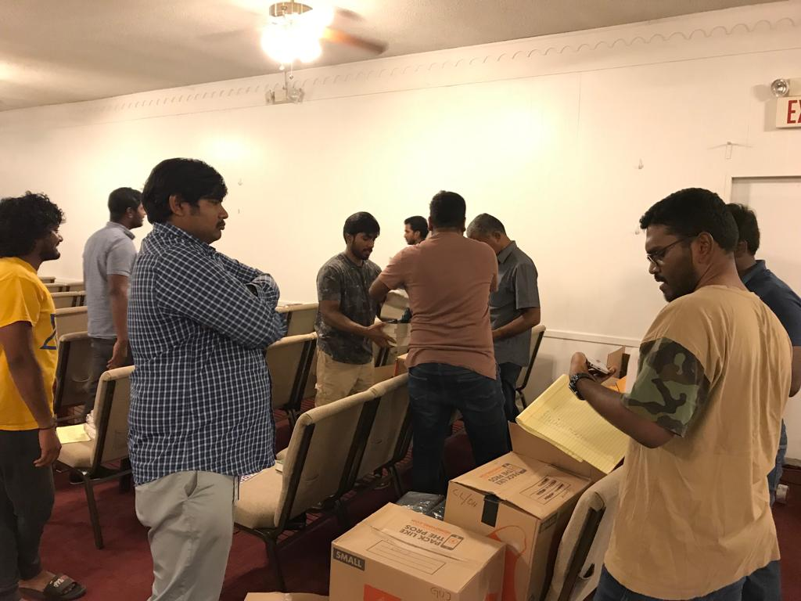
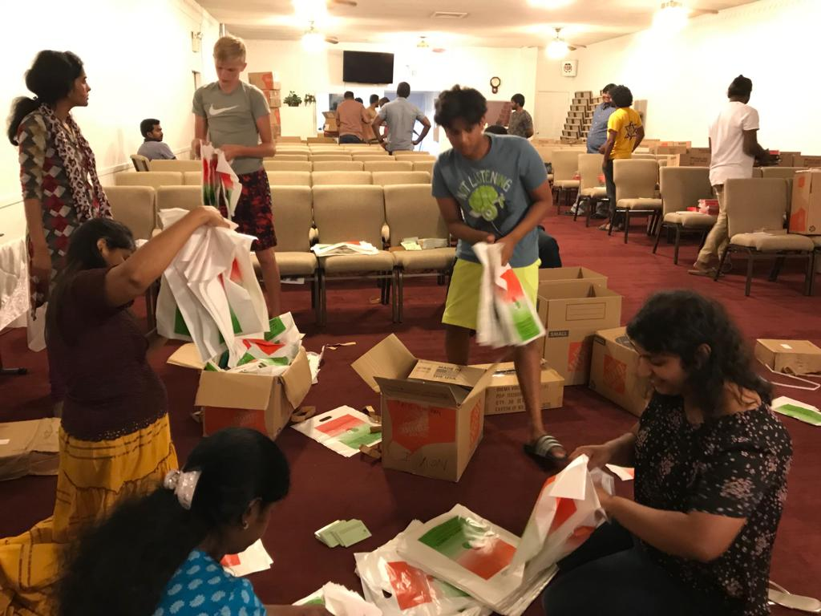
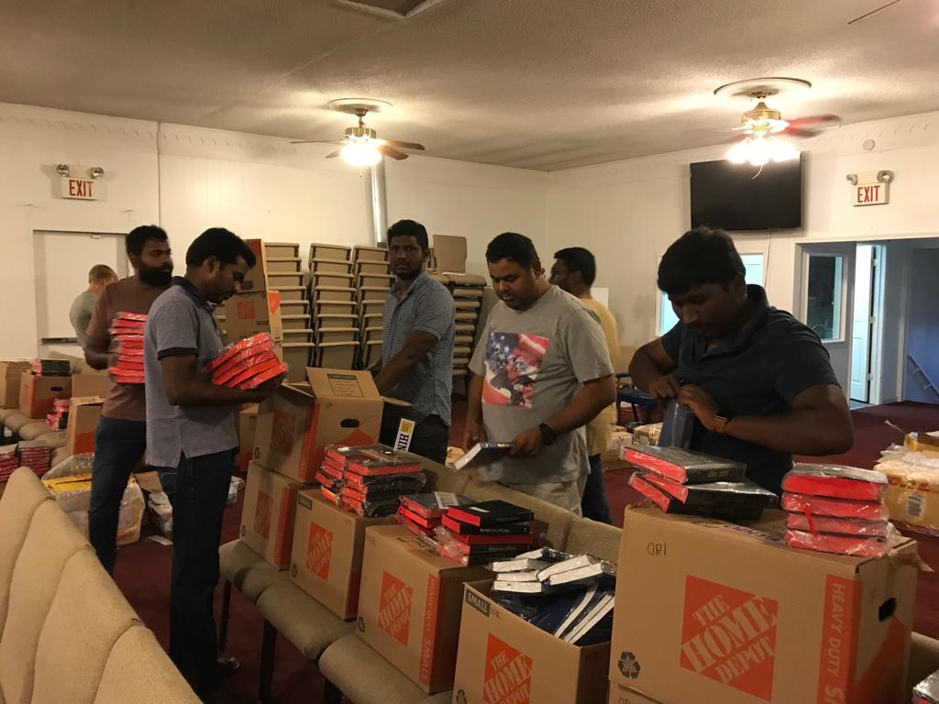
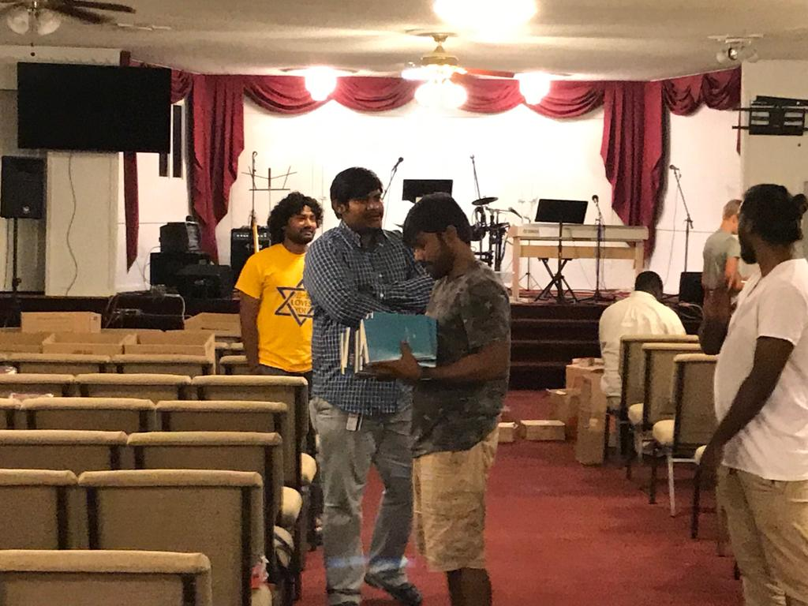
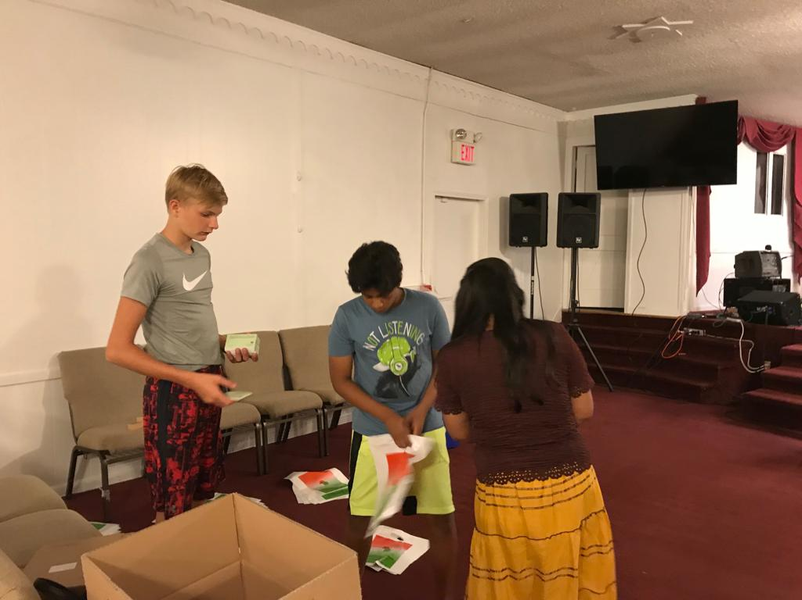
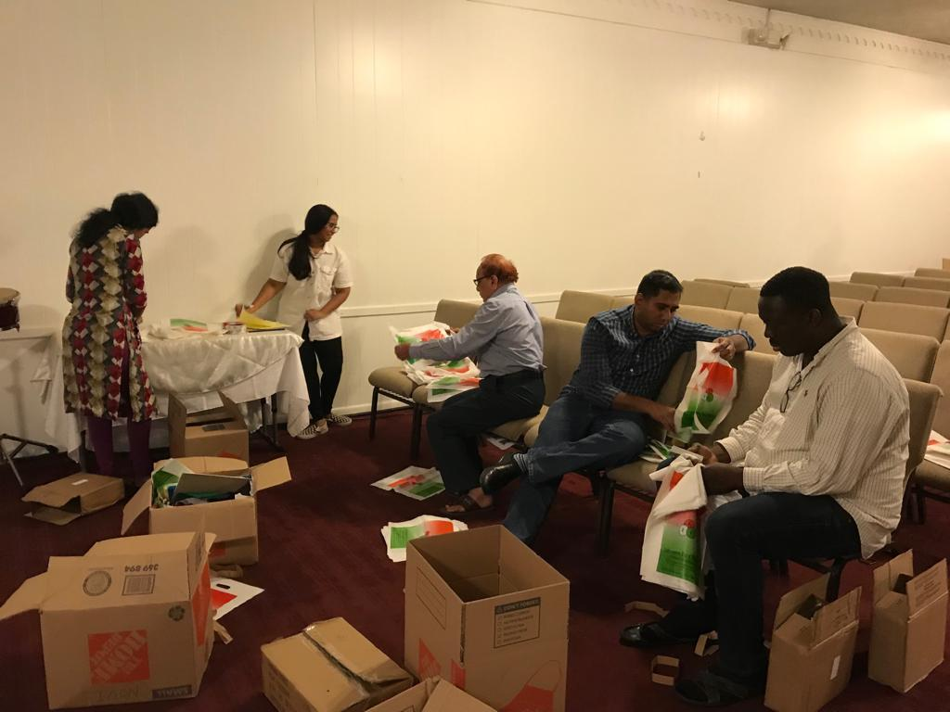
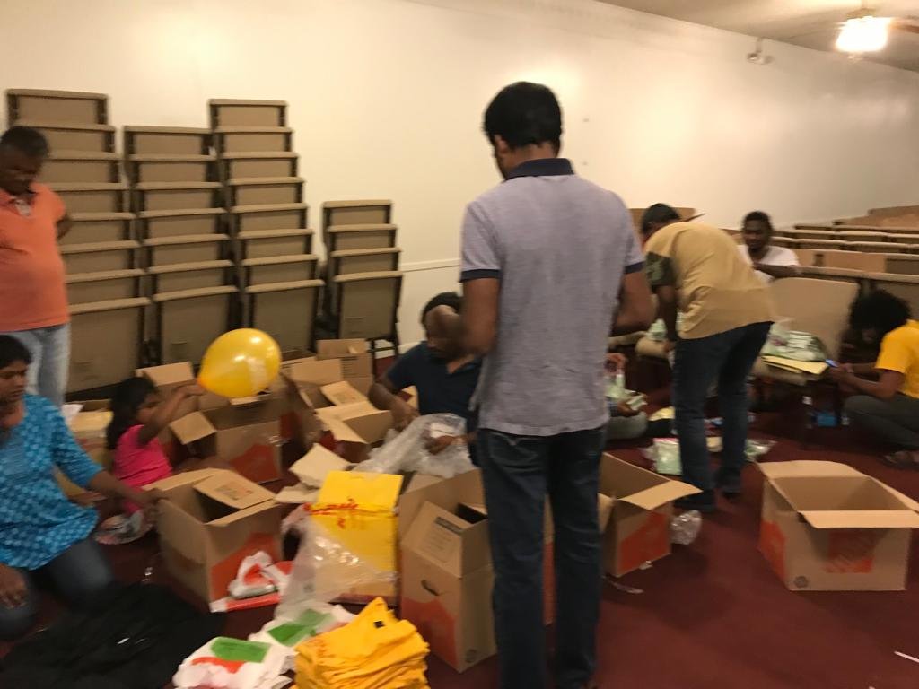
Preparation – ICA facility

Slide 4
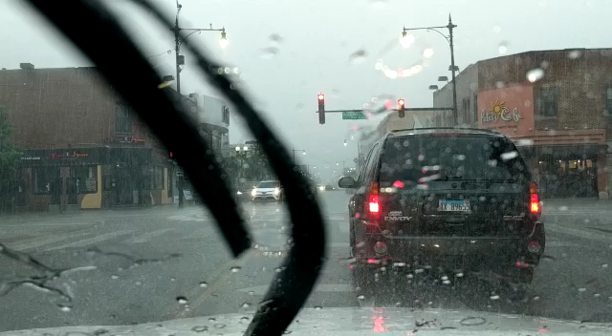
Minneapolis – MN & Chicago - IL
Several Volunteers travelled early in the morning with a lot of excitement to spread the good news in the streets of Chicago and Minneapolis but only to realize that rain has hindered the parade

Slide 5
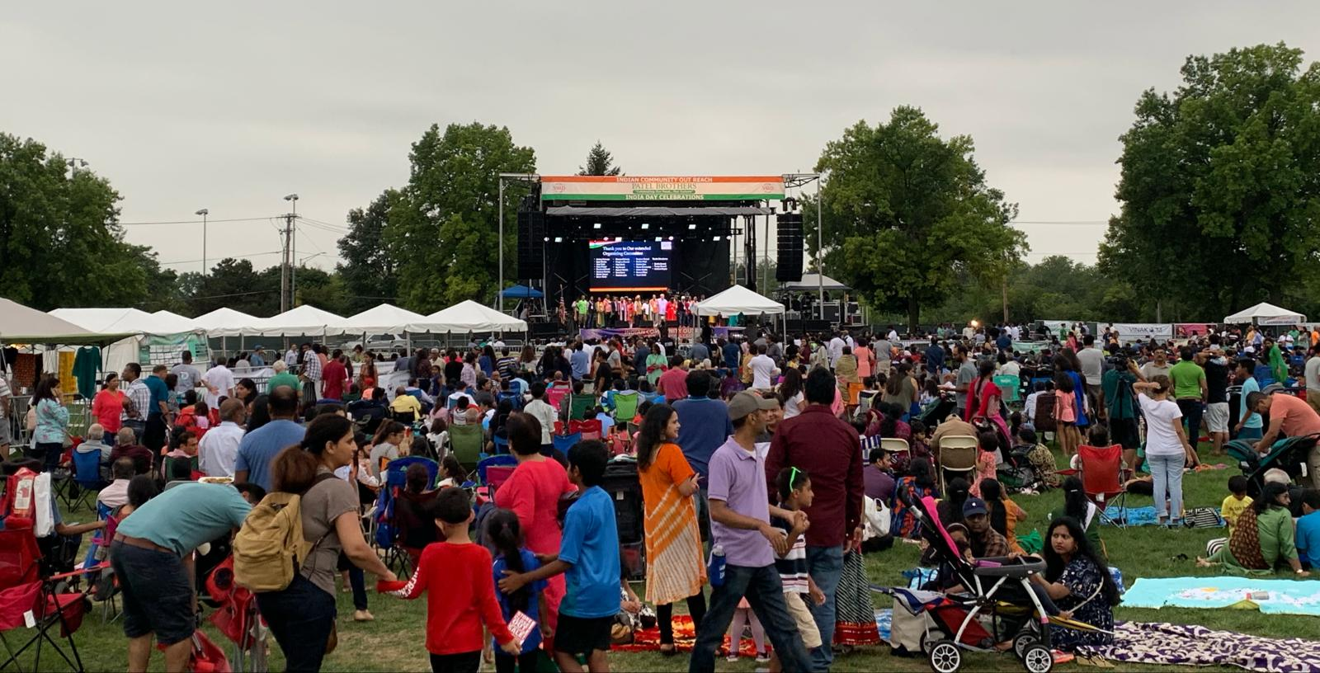
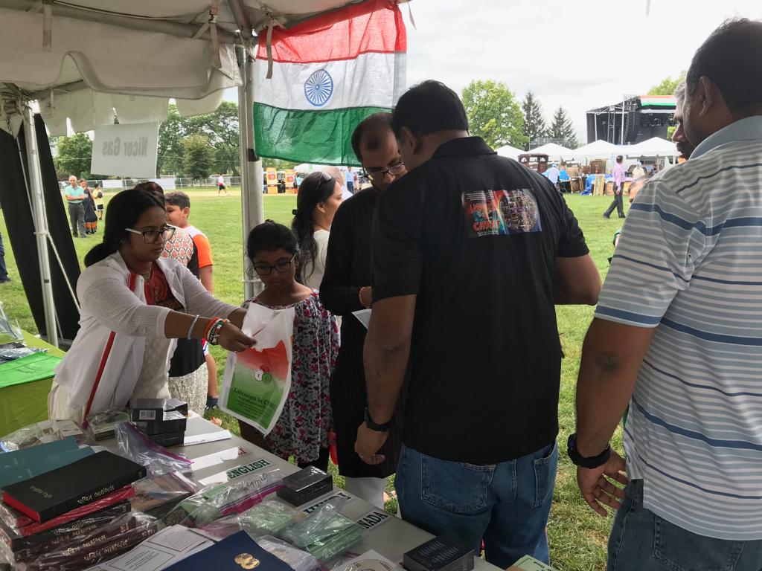
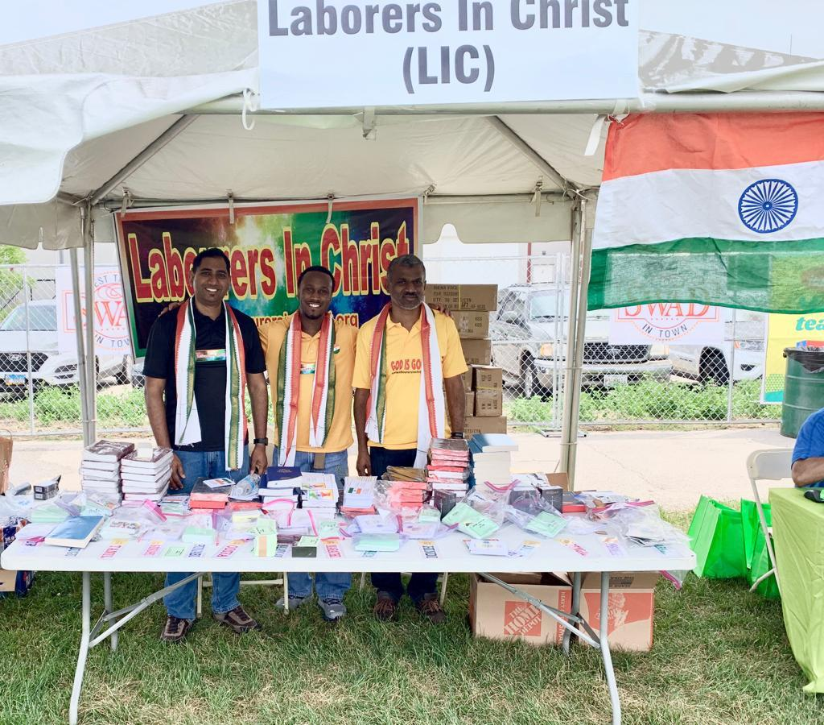
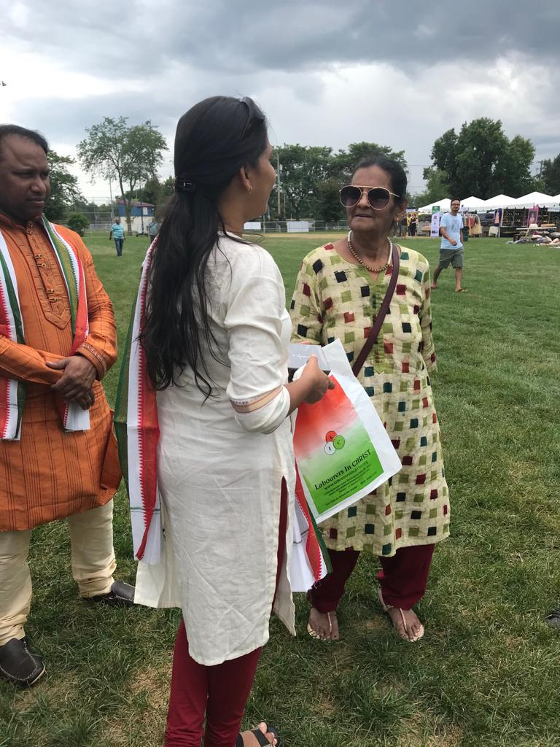
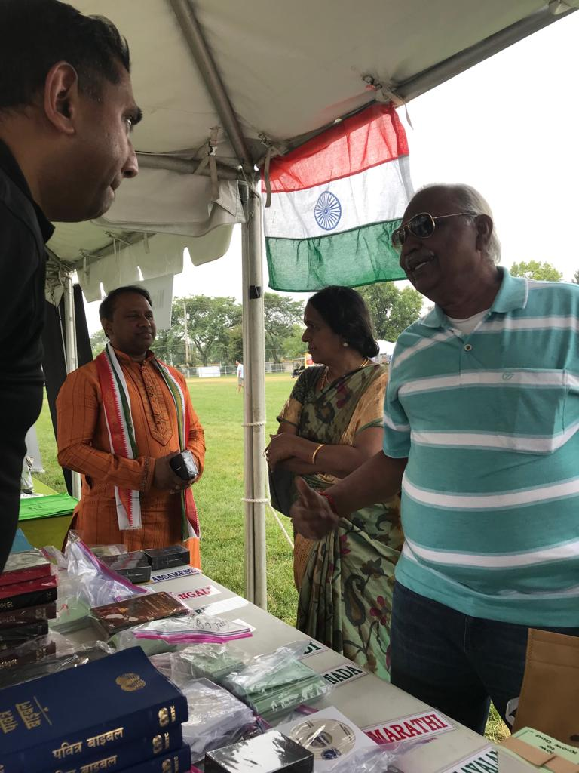
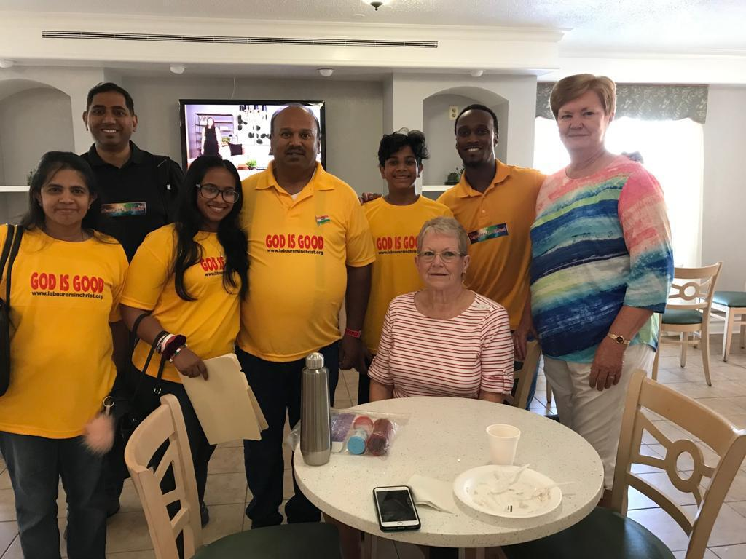
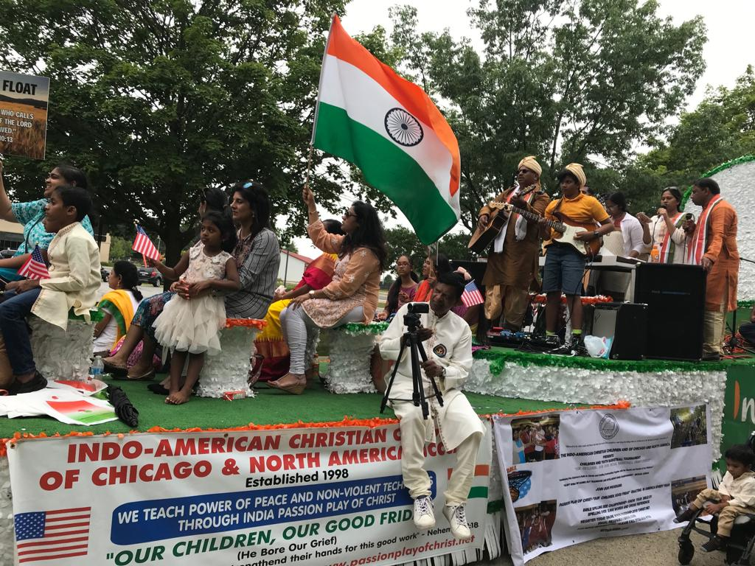
Naperville - IL

Slide 6
Naperville - IL
30,000
Footfalls
1,000
Gospel Tracts
Word
Several Bibles Given
Gospel proclaimed through songs

Slide 7
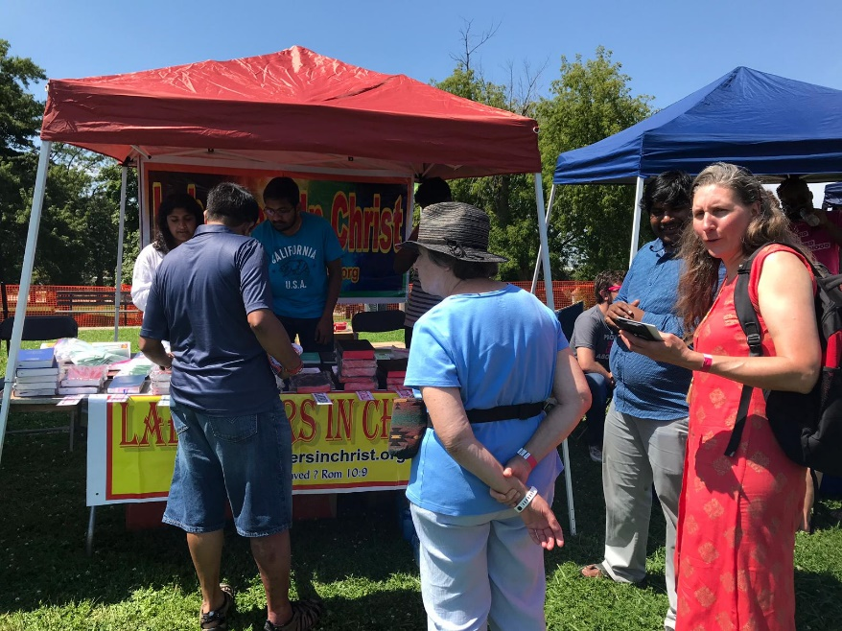
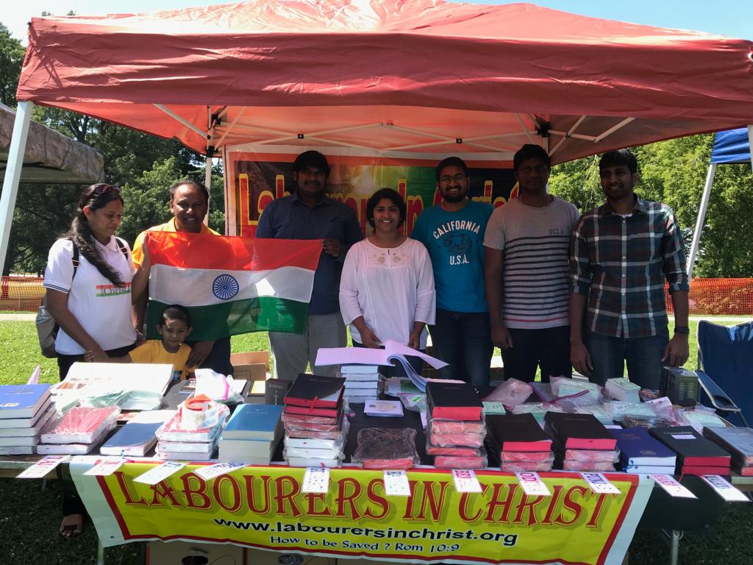
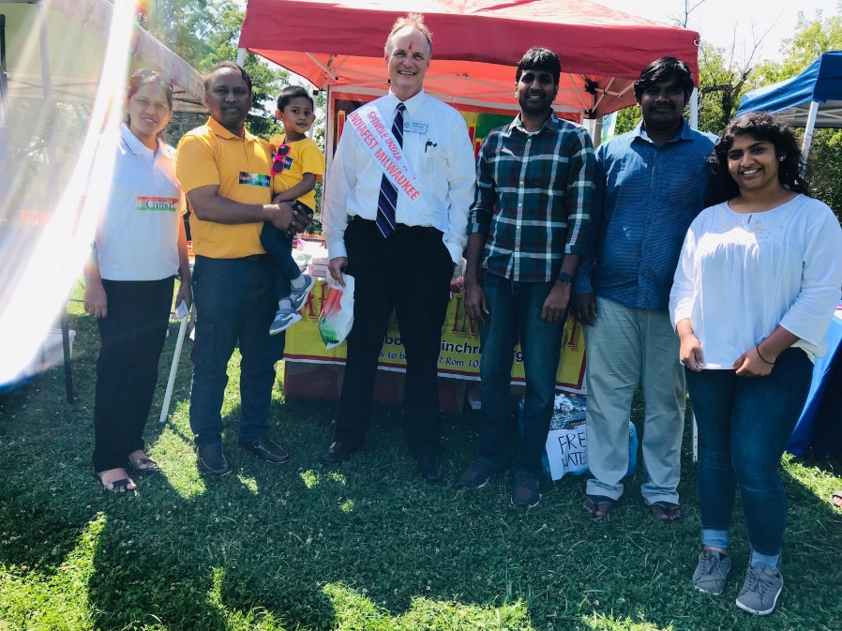
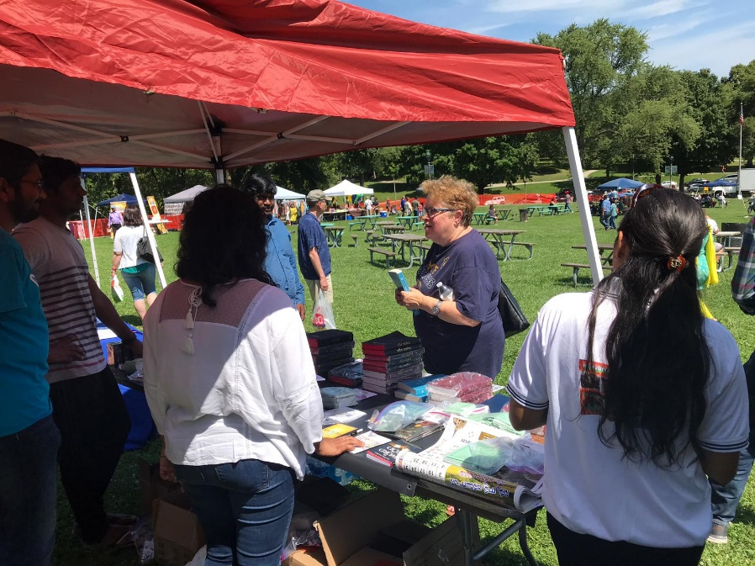
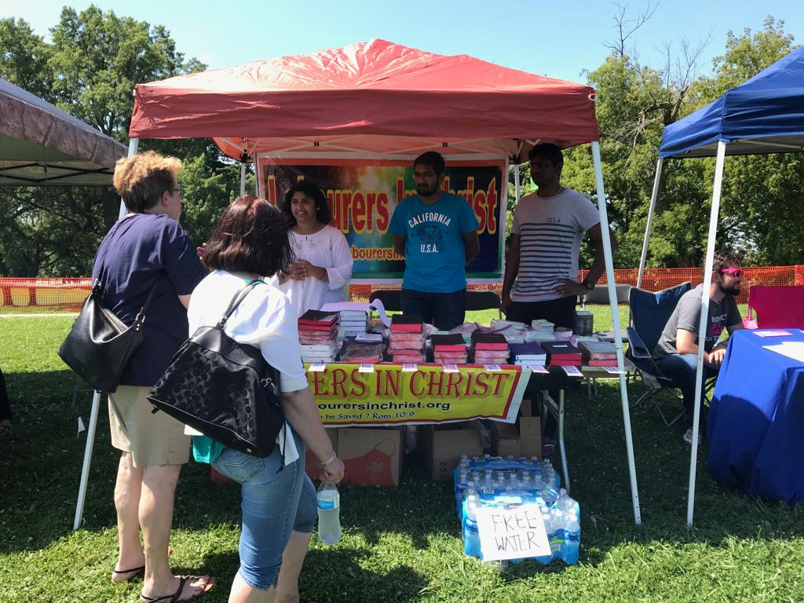
Milwaukee - WI

Slide 8
Milwaukee - WI
Thousands
Hundreds
Gospel Tracts
Word
Several Bibles Given
Footfalls

Slide 9
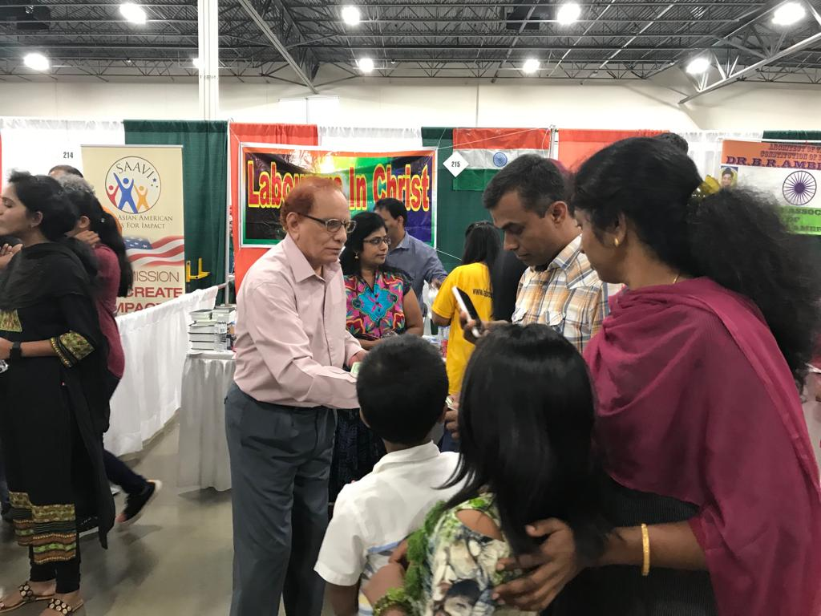
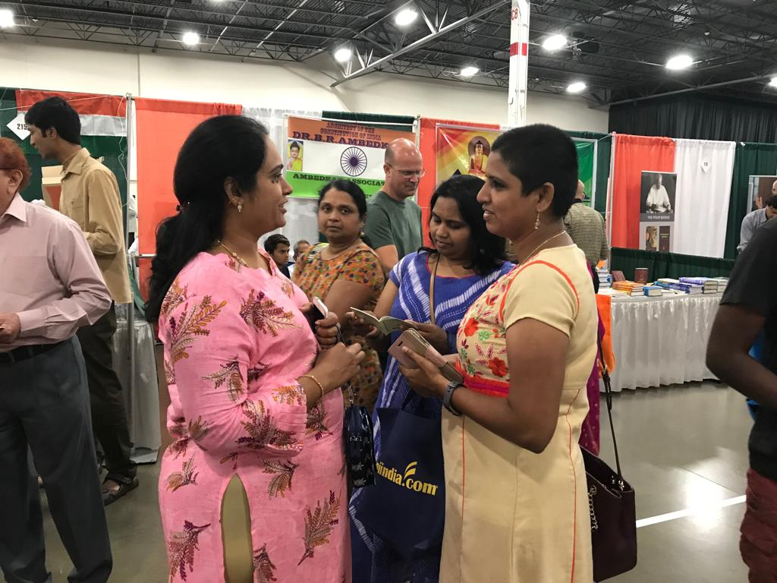
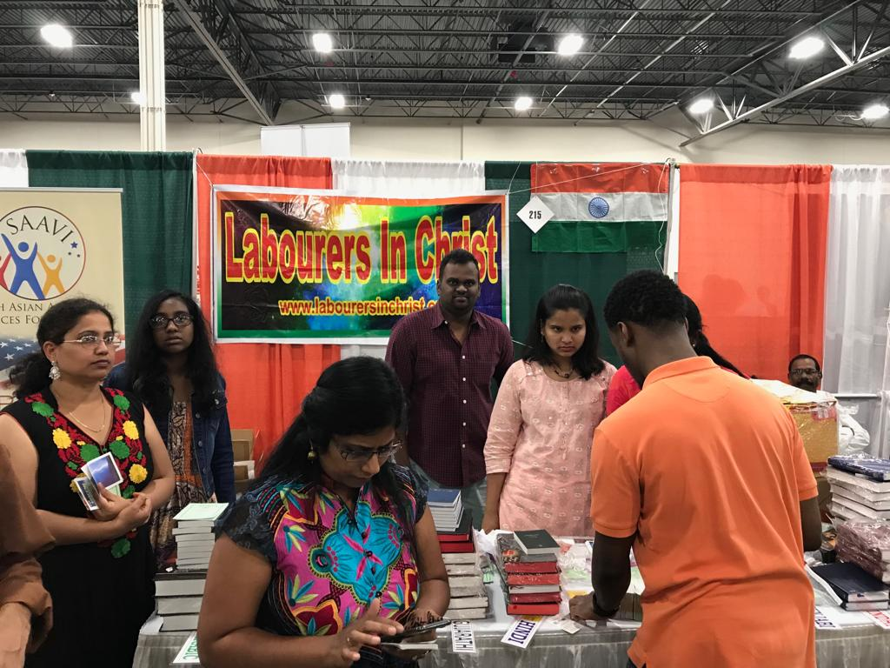
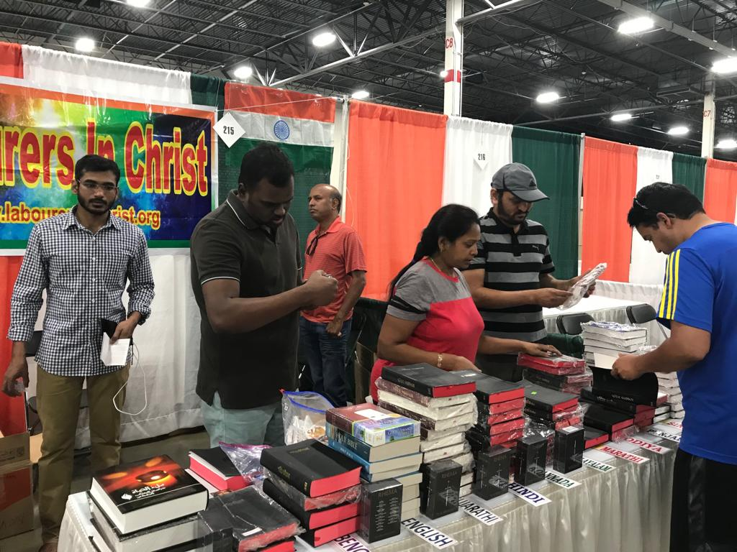
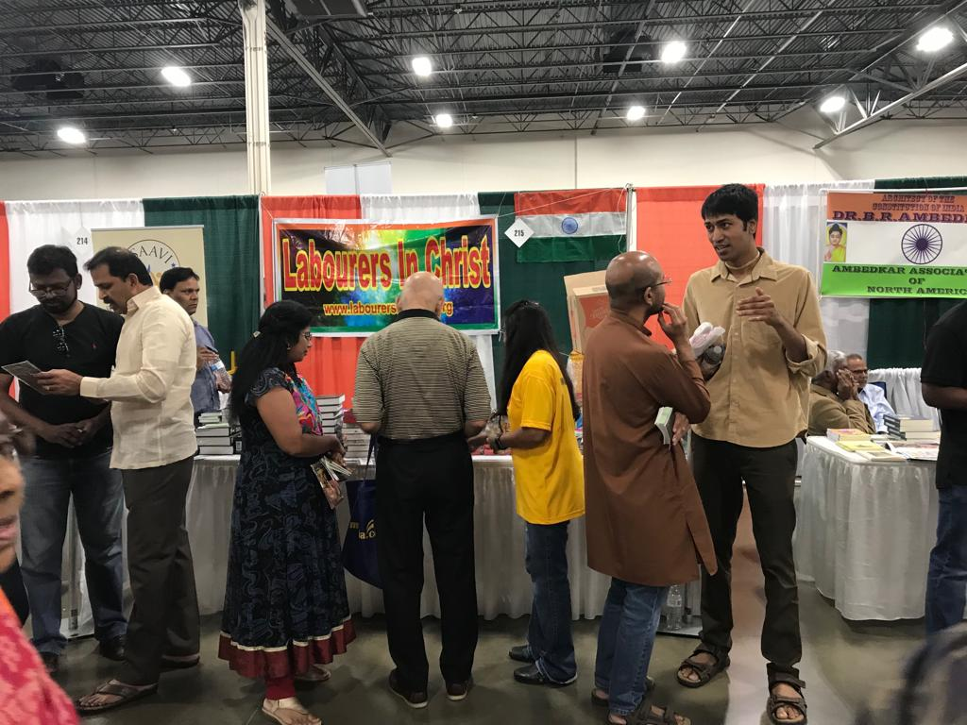
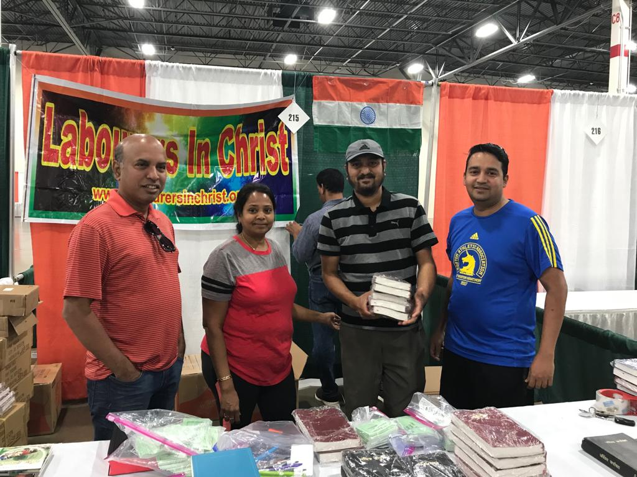
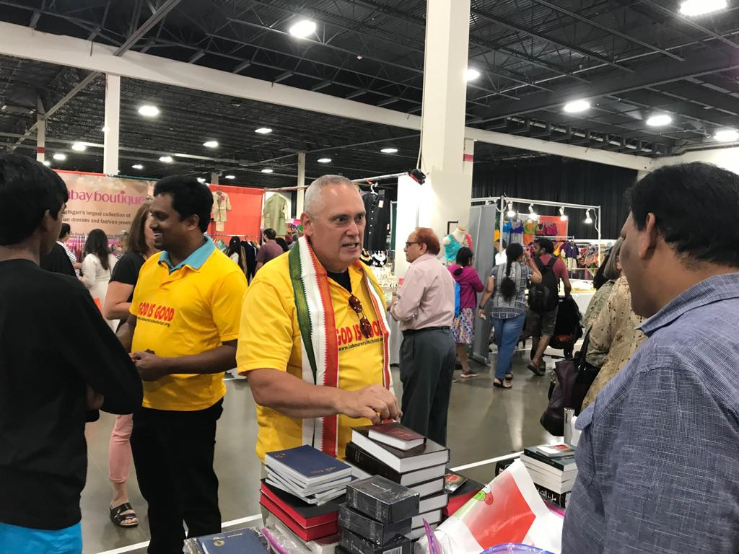
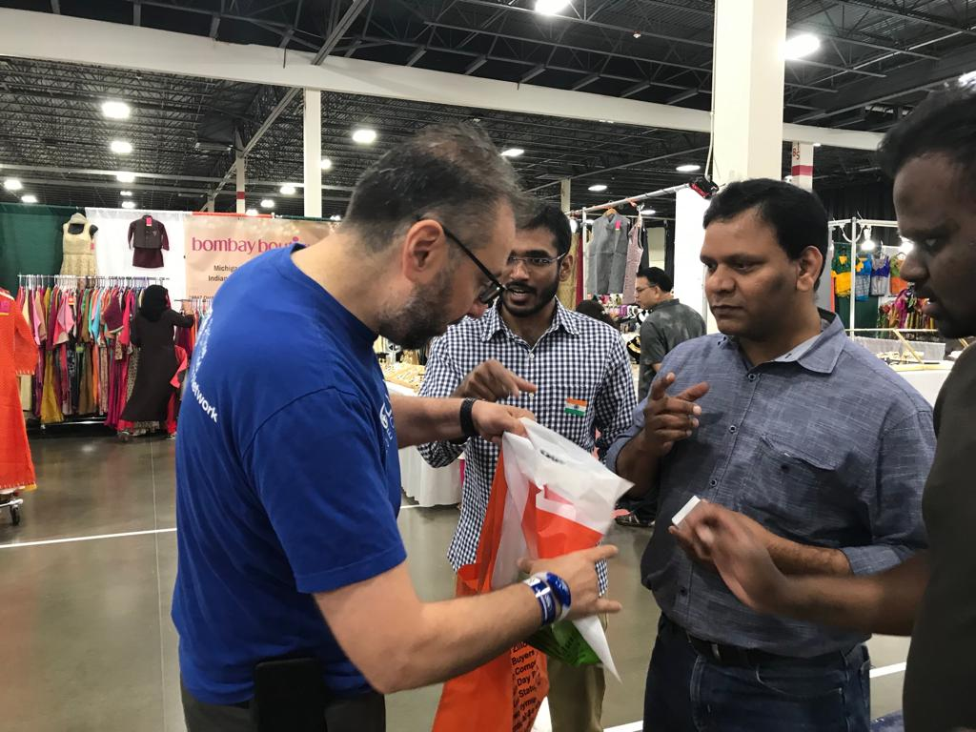
NOVI - MI

Slide 10
NOVI - MI
Testimony: One of persons who got a tract/literature from Novi India Day 2018 is a believer now and studying bible with her children daily and one of our team members is studying bible with her since last India day.
A SIMPLE TRACT HAS TRANSFORMED HER LIFE AND HER FAMILY.
Volunteers had a good spirited discussion about “TRUE GOD” with several people of other faiths
20,000
Footfalls
1,500
Gospel Tracts
Word
Several Bibles Given
Gospel proclaimed through conversations

Slide 11
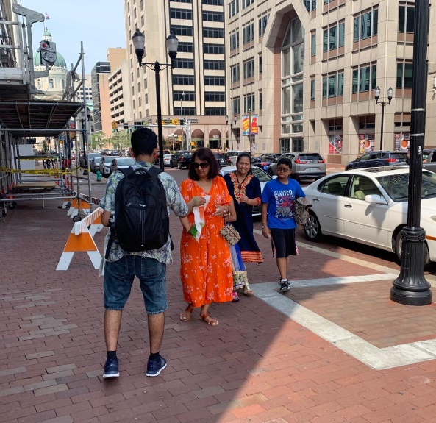
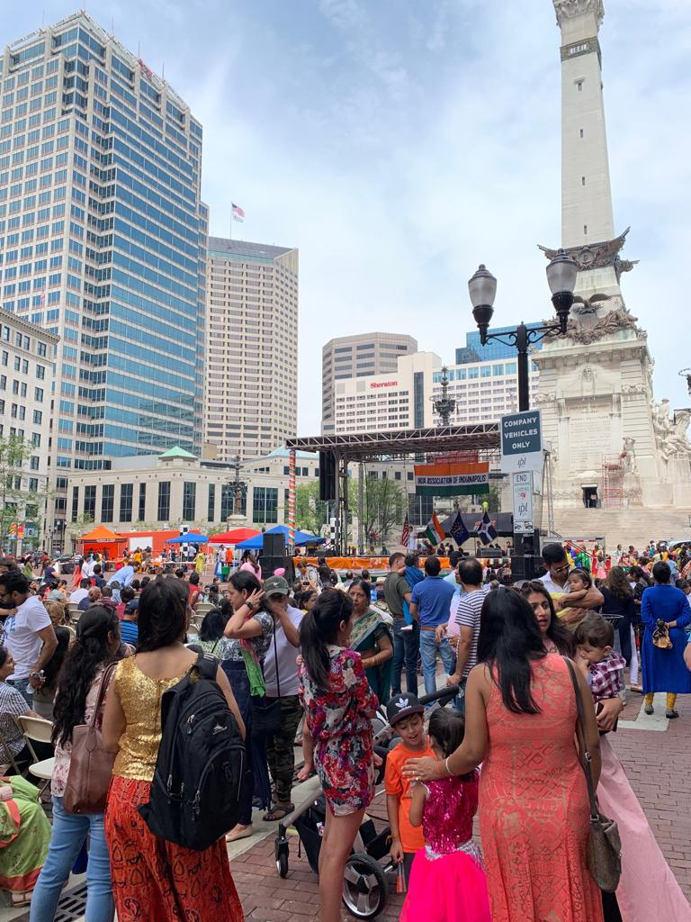
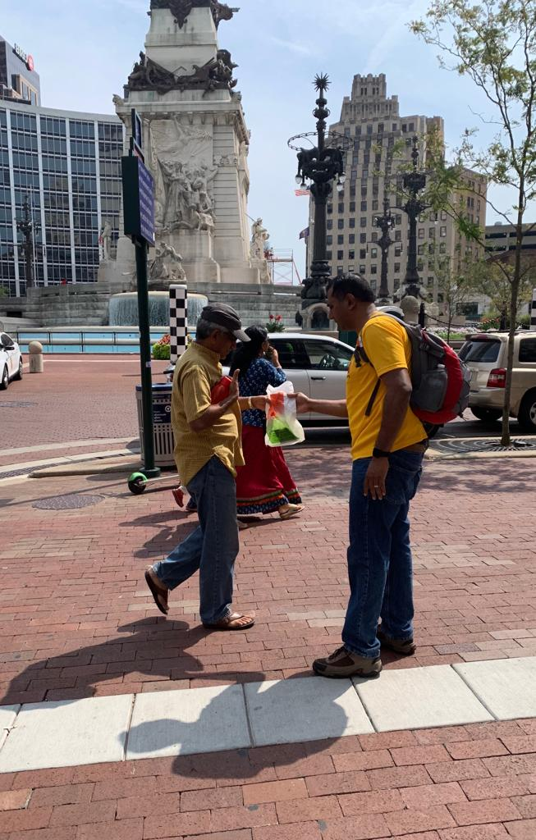
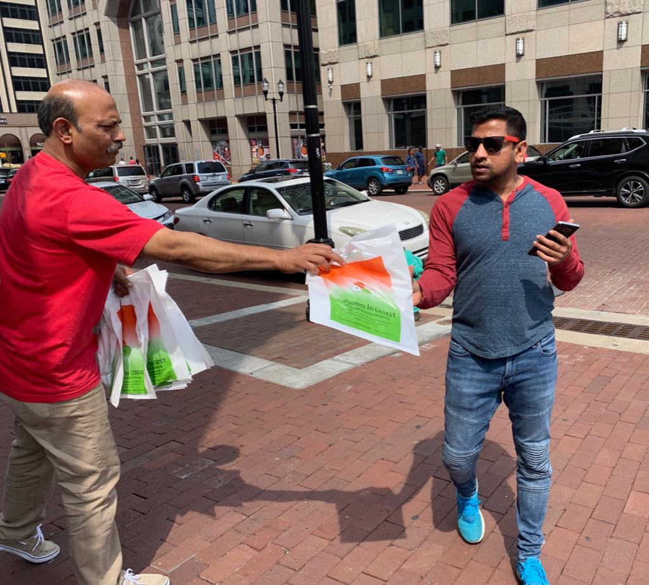
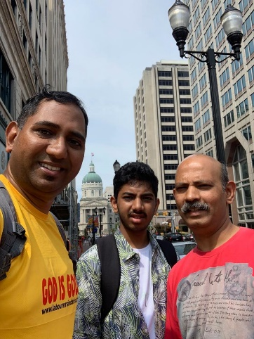
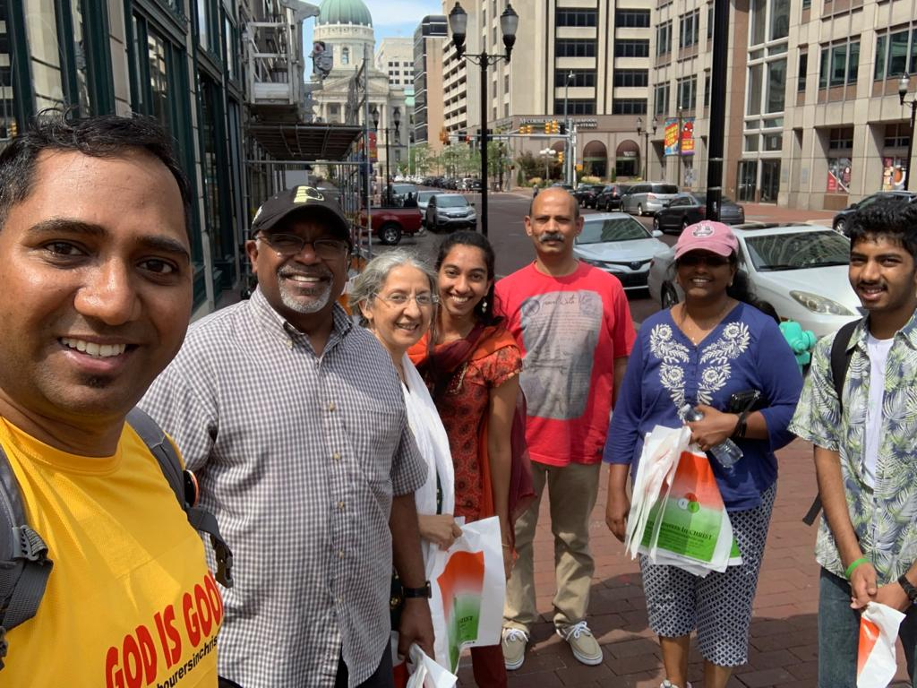
INDIANAPOLIS - IN

Slide 12
INDIANAPOLIS - IN
Thousands
Footfalls
500
Gospel Tracts
Word
Gospel proclaimed through conversations

Slide 13
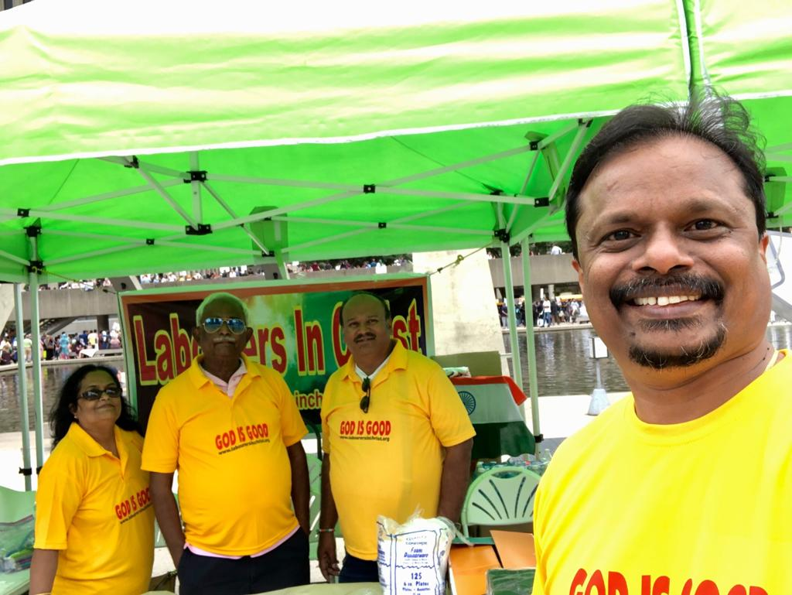
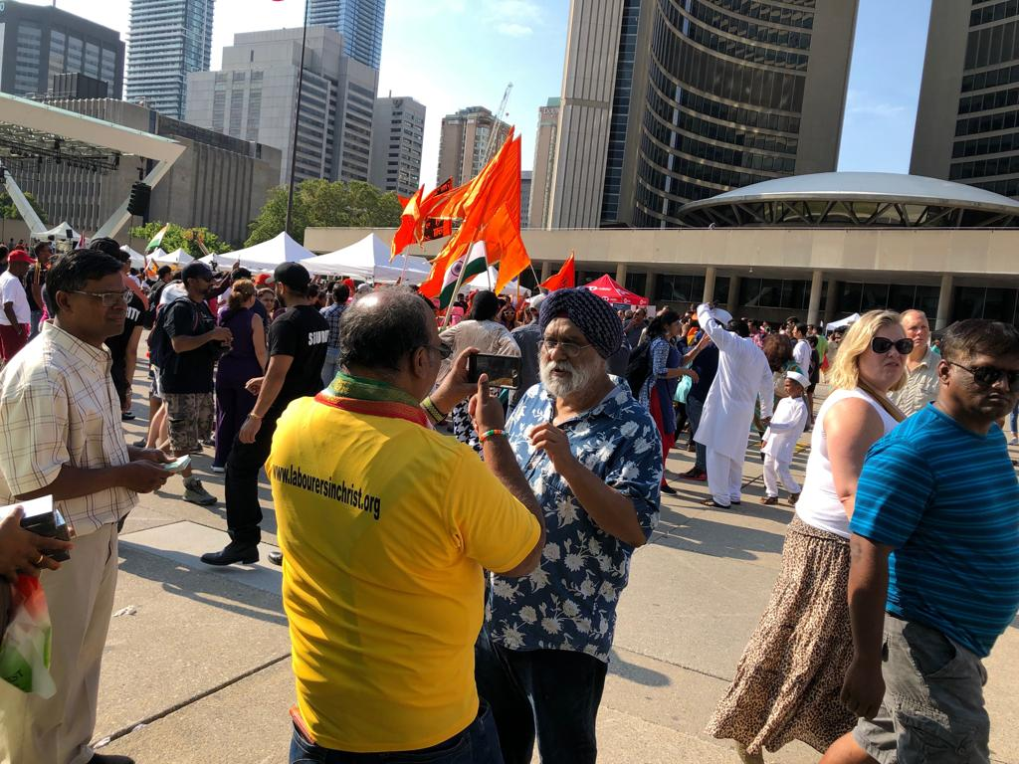
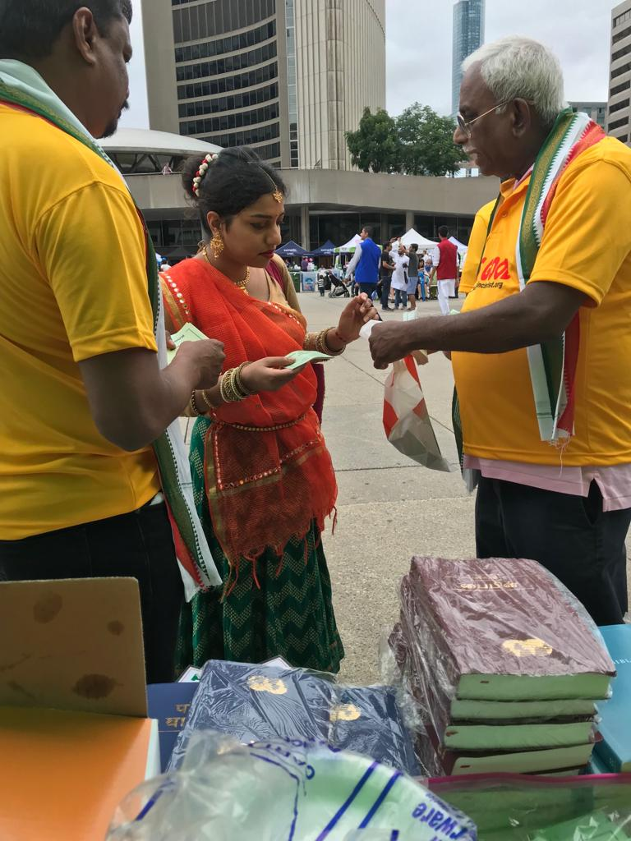
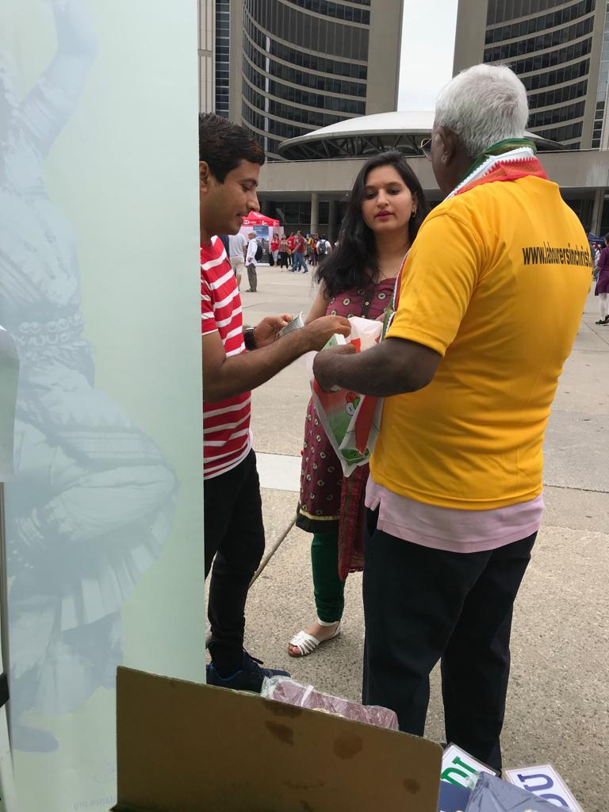
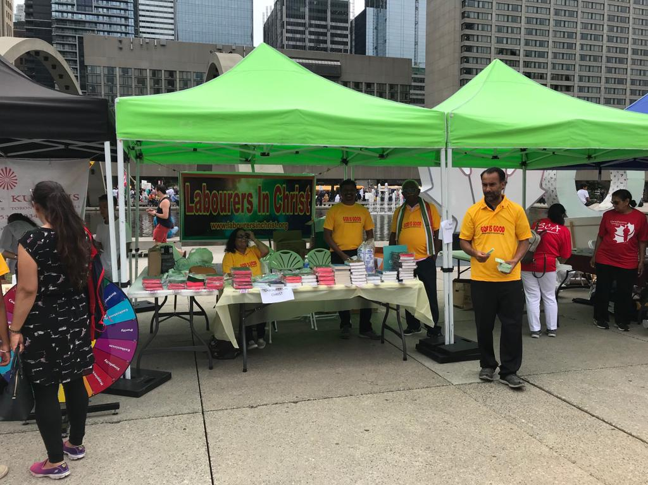
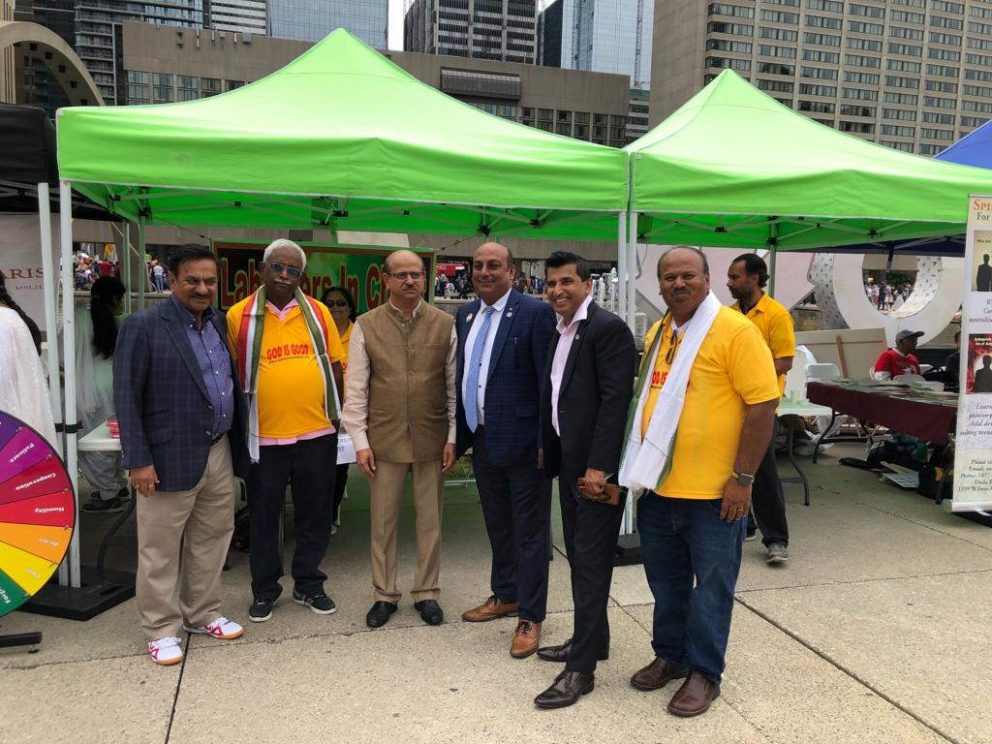
TORONTO - CANADA

Slide 14
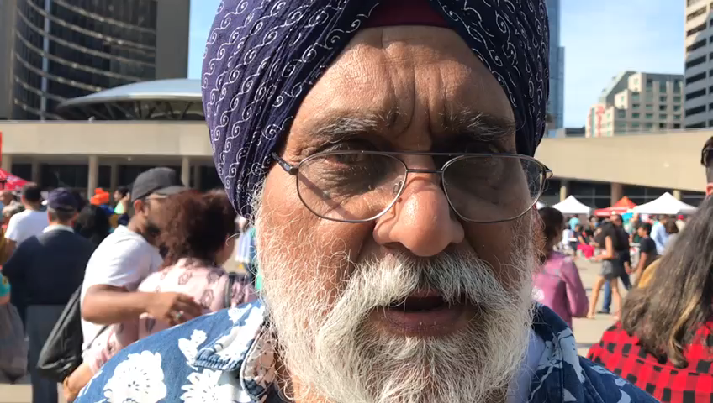
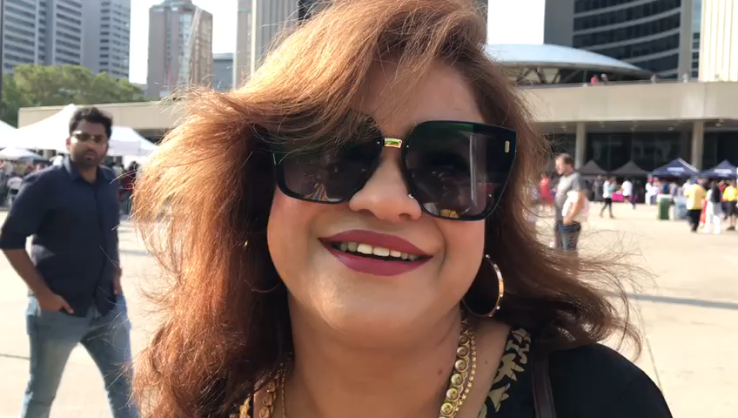
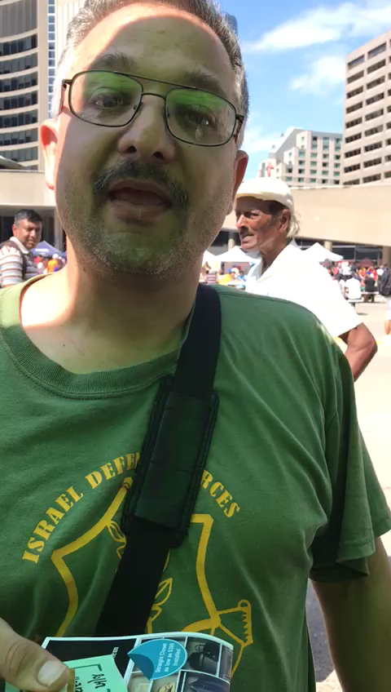
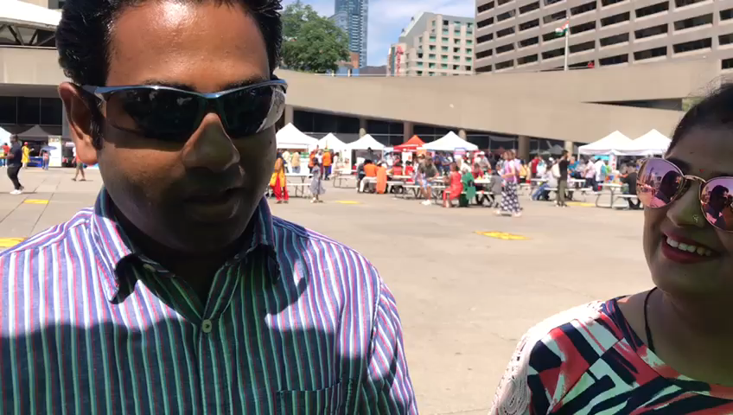
TORONTO - CANADA
Testimony: One person took a Punjabi Bible at the Yonge and Dundas square outreach several years and states that he is reading the Bible and also book written by Sadhu Sunder Singh.
Search of Bibles in native language ends at LIC booth!
25,000
Footfalls
500
Gospel Tracts
Word
Gospel proclaimed through conversations
Several Bibles Given

